Slide 1
PSERP odiya – exam & result

Slide 2
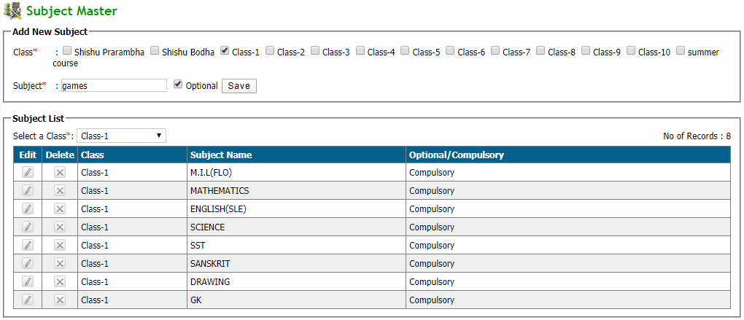
Q: To add new subject
Click Exam & Result → Examination & Result → Define Classwise Subject
Enter new subject details in add new subject box and click save button
Edit: Click edit button in edit column and then modify subject and click update button
Delete: Click delete button in delete column of corresponding subjects

Slide 3
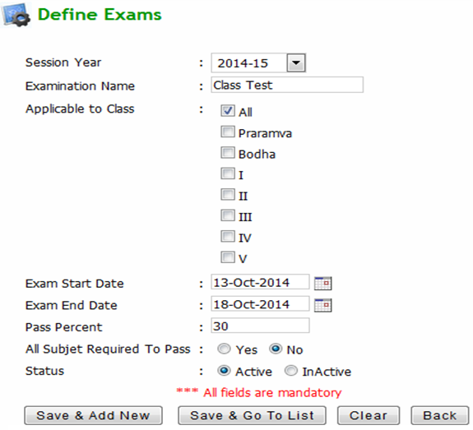
Q: To define exams for each class
Click Exam & Result → Examination & Result → Define Exams
Click add new button and this will redirect to define exams page
Enter all required details and click save & add new button or save & go to list button according to your need

Slide 4
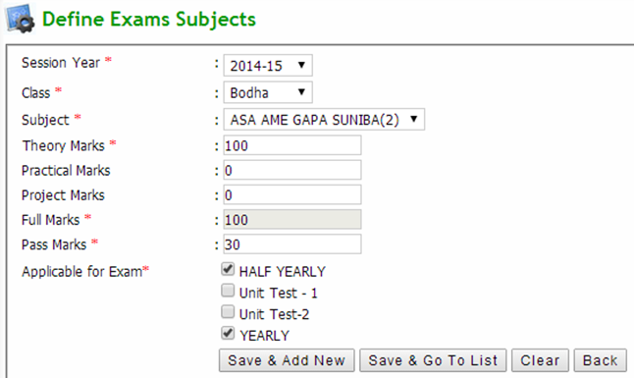
Q: To Define Exam Subjects
Click Exam & Result → Examination & Result → Define Exam Subject
Click add new button and this will redirect to define exams page
Enter all required details and click save & add new button or save & go to list button according to your need

Slide 5
Q: To view examination
Click Exam & Result → Examination & Result → Define Exams
Select search parameters and click search button
Edit: Click edit button in action column and then modify subject and click update button
Delete: Select the checkbox to be deleted and click delete exam details button
Export to excel: Click on export to excel button to export the report to an excel file
Click import data from prev session button to copy all Exam type from previous session to new session then click on import data from prev session button

Slide 6
Q: To assign optional subject to students
Click Exam & Result → Examination & Result → Assign Optional Subjects
Select search parameters and the list will appear
Assign optional: Select desired student checkbox and click assign button to assign the optional subject to the selected students
Un-Assign optional: Select desired student checkbox and click un-assign button to un-assign the optional subject to the selected students

Slide 7
Q: To give exam attendance to students
Click Exam & Result → Examination & Result → Exam Attendance
Select search parameters and the list will appear
Present: Select desired student checkbox and click mark as present button to assign present to the selected students
Absent: Select desired student checkbox and click mark as absent button to assign present to the selected students

Slide 8
Q: To give exam marks to students
Click Exam & Result → Examination & Result → Enter Exam Marks
Select student from the dropdown
Enter marks of the student in the marks field and click save button to save respective subject marks

Slide 9
Q: To modify exam marks of students
Click Exam & Result → Examination & Result → Modify Exam Marks
Select search parameters and select student from the dropdown
Enter modified marks of the student in the marks field and click save button to save respective subject marks

Slide 10
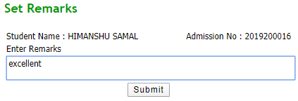
Q: To set remarks for students
Click Exam & Result → Examination & Result → Set Remarks for Exam Performance
Select search parameters and the list will appear
Set Remarks: Click set remarks link in set remarks column and enter remarks and click submit button
View Remarks: Click view link in set remarks column to view remark

Slide 11
Q: To generate result of students
Click Exam & Result → Examination & Result → Generate Results
Select search parameters and click generate result button

Slide 12
Q: To modify exam marks of students after paper rechecking
Click Exam & Result → Examination & Result → Exam Paper Rechecking
Select search parameters and select student from the dropdown
Enter modified marks of the student in the marks field and click save button to save respective subject marks

Slide 13
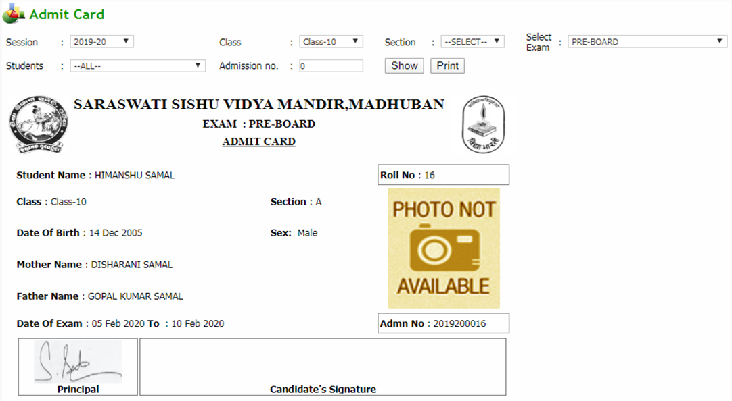
Q: To print admit card
Click Exam & Result → Siting Plan Indexing → Print Admit Card
Select search parameters and click show button to get admit card
Print: Click on print button to print the admit card

Slide 14
Q: To get Exam Attendance Report
Click Exam & Result → Reports → Exam Attendance Report
Select search parameters and click show button to get the report
Export to excel: Click on export to excel button to export the report to an excel file
Print: Click on print button to print the report

Slide 15
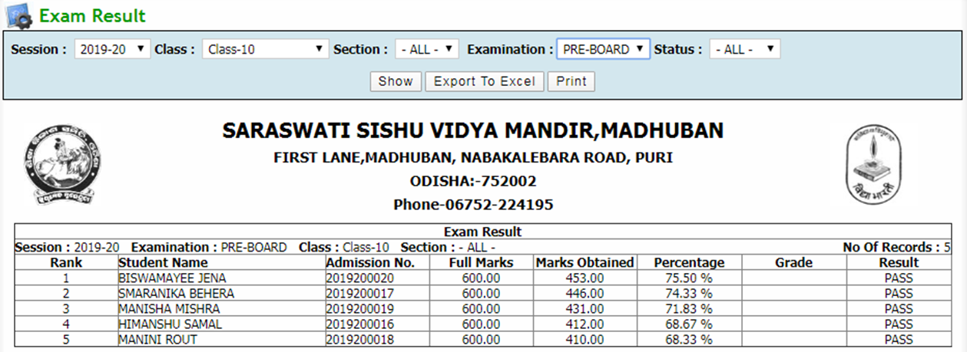
Q: To get Exam Results
Click Exam & Result → Reports → Exam Result
Select search parameters and click show button to get the result
Export to excel: Click on export to excel button to export the result to an excel file
Print: Click on print button to print the result

Slide 16
Q: To get Student Marksheet
Click Exam & Result → Reports → Student Marksheet
Select search parameters and click show button to get the result
Export to excel: Click on export to excel button to export the result to an excel file
Print: Click on print button to print the result

Slide 17
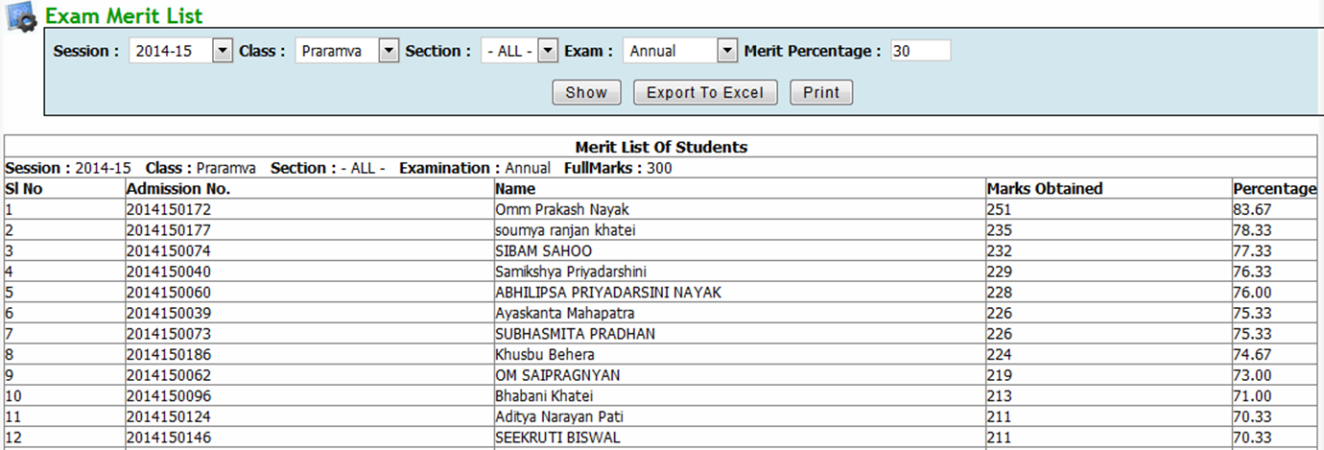
Q: To get Exam Merit List
Click Exam & Result → Reports → Exam Merit List
Select search parameters and click show button to get the list
Export to excel: Click on export to excel button to export the list to an excel file
Print: Click on print button to print the list

Slide 18
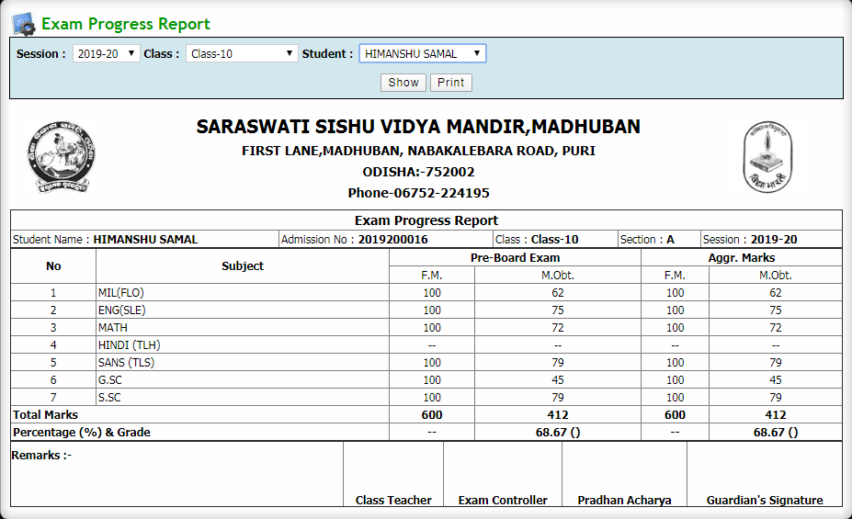
Q: To get Exam Attendance Report
Click Exam & Result → Reports → Exam Progress Report
Select student from dropdown and click show button to get the report
Print: Click on print button to print the report

